Slide 1
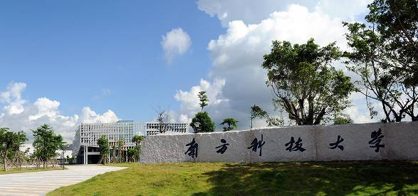
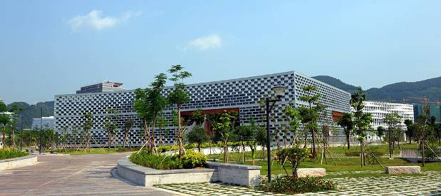
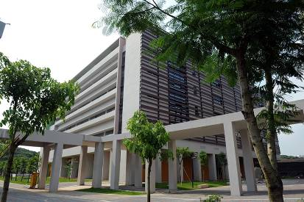
Engineering Electromagnetics 工程电磁场
Youwei 嘉有为

Slide 2

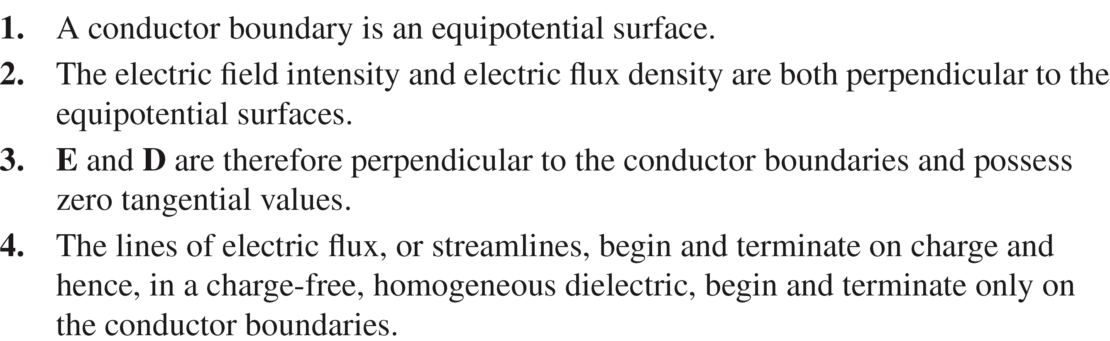
10: Capacitance
Using Field Sketches to Estimate Capacitance
This method employs these properties of conductors and fields:
25

Slide 3
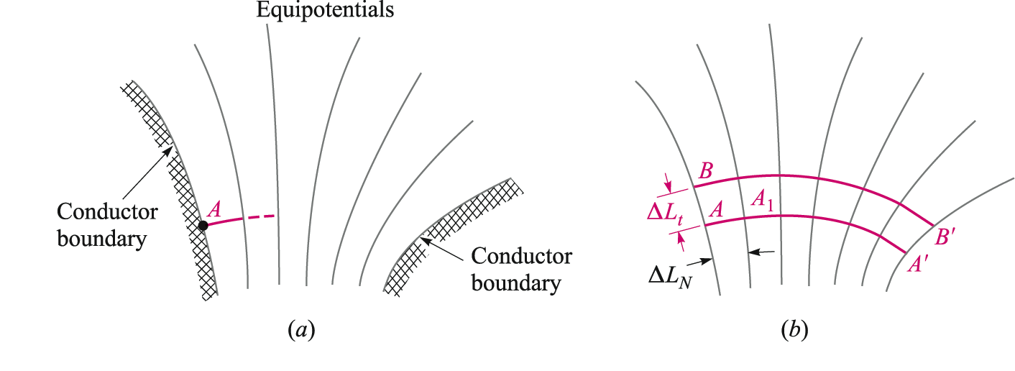
10: Capacitance
Using Field Sketches to Estimate Capacitance
Given the conductor boundaries, equipotentials may be sketched in. An attempt is made to establish approximately equal potential differences between them.
A line of electric flux density, D, is then started (at point A), and then drawn such that it crosses equipotential lines at right-angles.
26

Slide 4
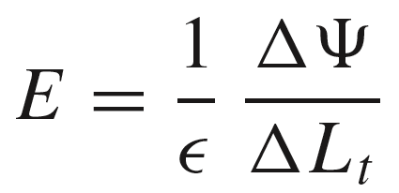
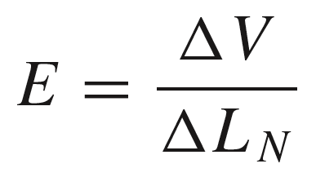
10: Capacitance
Using Field Sketches to Estimate Capacitance
Two Lines of D are shown (sketched in red). All field lines must intersect equipotentials at 90⁰.
The volume between the two red field lines (having unit depth into the screen) forms a “tube” of flux, of amount Δψ. This is the same as the charge on the conductor that is bounded by the tube.
The electric field can now be written as:
Then, assuming potential difference ΔV between adjacent equipotentials, we may also write the electric field as:
27

Slide 5
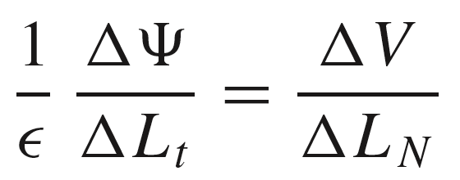
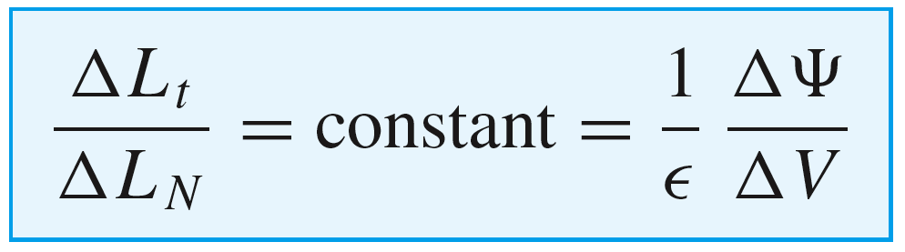



10: Capacitance
Using Field Sketches to Estimate Capacitance
We now have two expressions for electric field, based on the line spacing in the sketch:
Setting the two expressions equal results in
or:
In other words, the sketch is done such that the ratio / is fixed. The easiest way to do this is to make
So draw the sketch such that each grid segment is approximately square
28

Slide 6

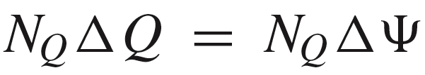

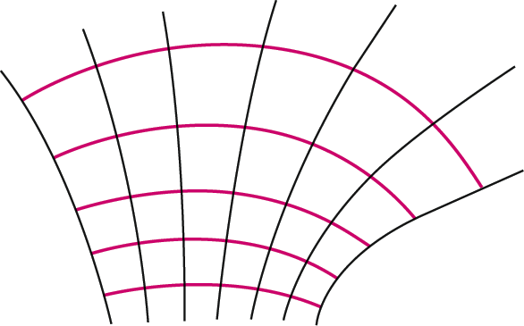

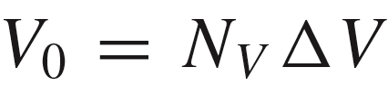
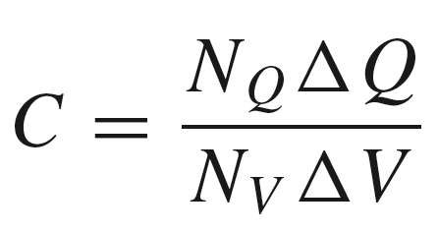
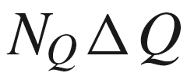
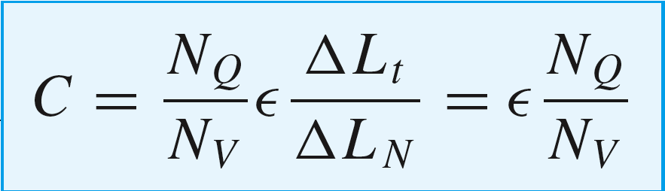

10: Capacitance
Using Field Sketches to Estimate Capacitance
Here we see the completed sketch, drawn such that the region is divided into curvilinear squares 曲边正方形. Each segment along the conductor walls (again of unit depth) contains flux Δψ, (or charge ΔQ). Each distance increment between conductors represents a change in potential of ΔV.
The number of segments along the conductor wall is N_{Q}, the total charge on either conductor is therefore:
The number of segments between conductors is N_{V}, the potential difference between conductor is therefore:
So that the capacitance is now:
or finally:
29

Slide 7
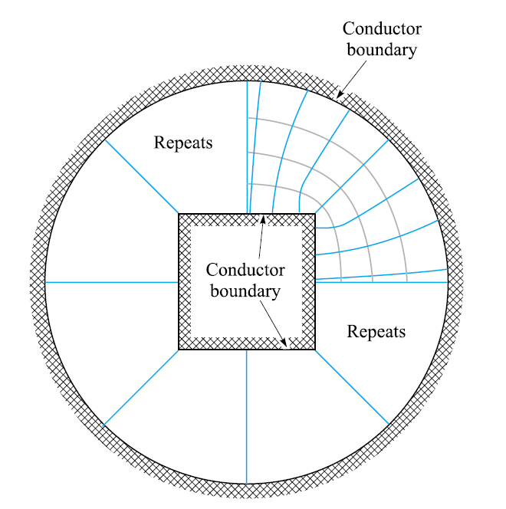
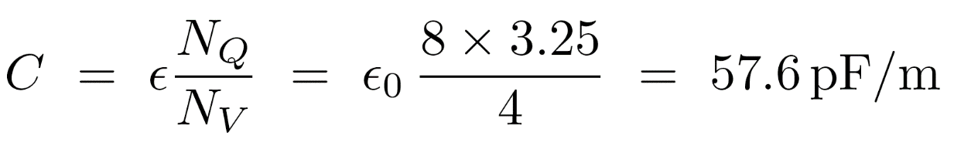
10: Capacitance
Using Field Sketches to Estimate Capacitance
Example
In this transmission line, we wish to estimate
the capacitance per unit length. The field and
equipotential lines in one quadrant are shown.
In this case, division of the range parallel to
the conductors into an integral number of squares
was not achieved. Instead, over one-eighth of the
distance around the perimeter, we have 3.25 divisions.
Between conductors there are exactly four squares.
Therefore:
30

Slide 8
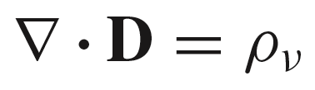


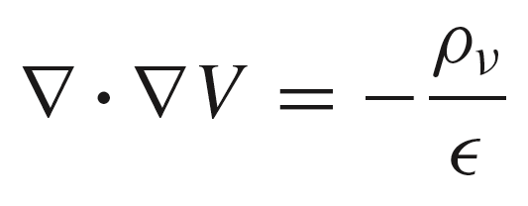
10: Capacitance
Poisson’s and Laplace’s Equations 泊松、拉普拉斯方程
These equations allow one to find the potential field in a region, in which values of potential or electric field are known at its boundaries.
Start with Maxwell’s first equation:
where
and
so that
or finally:
31

Slide 9
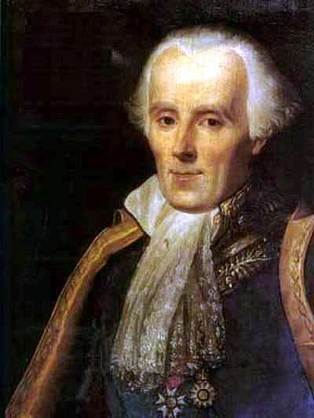
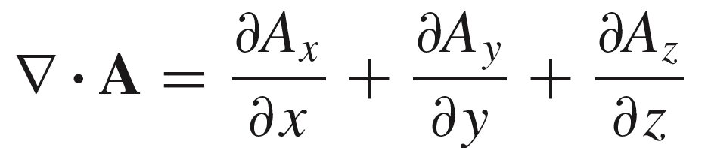
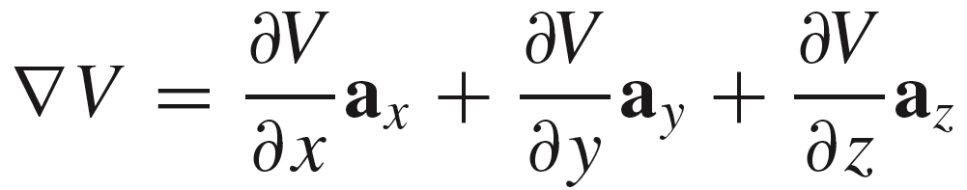
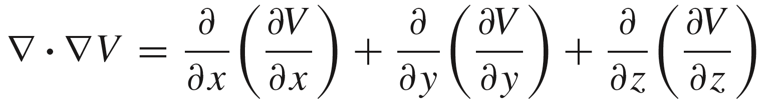
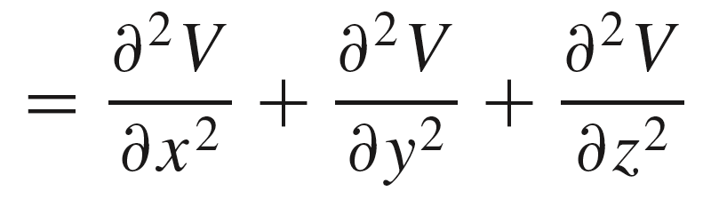
10: Capacitance
Poisson’s and Laplace’s Equations
Recall the divergence as expressed in rectangular coordinates:
…and the gradient:
Pierre-Simon Laplace
(1749-1827)
then:
It is known as the Laplacian operator.
32

Slide 10
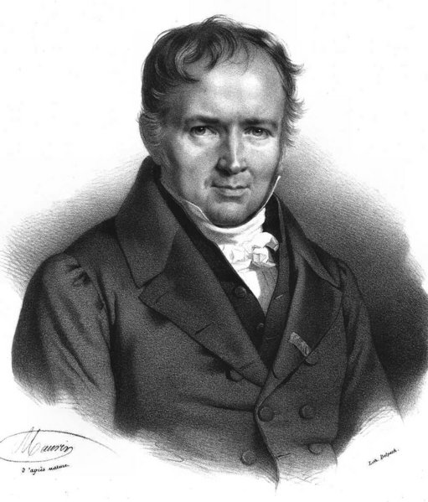
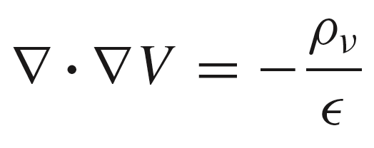
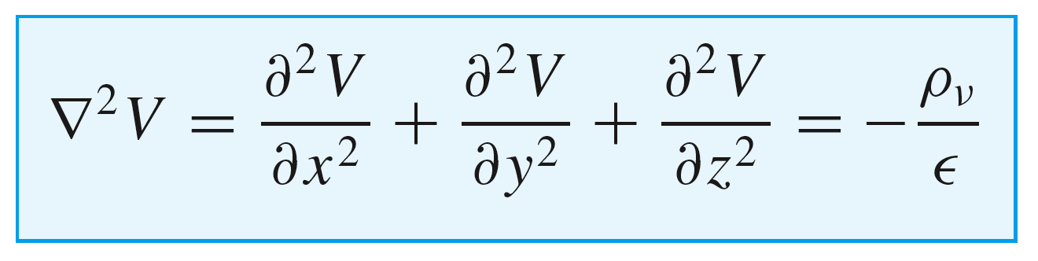
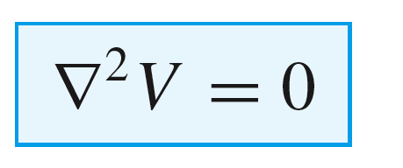
10: Capacitance
Poisson’s and Laplace’s Equations
we already have:
which becomes:
Siméon Denis Poisson
(1781-1840)
This is Poisson’s equation, as stated in rectangular coordinates.
In the event that there is zero volume charge density, the right-hand-side becomes zero, and we obtain Laplace’s equation:
33

Slide 11
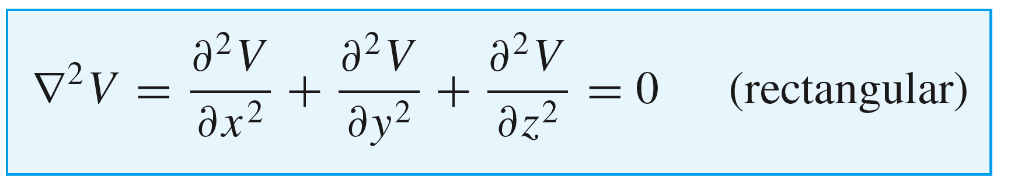
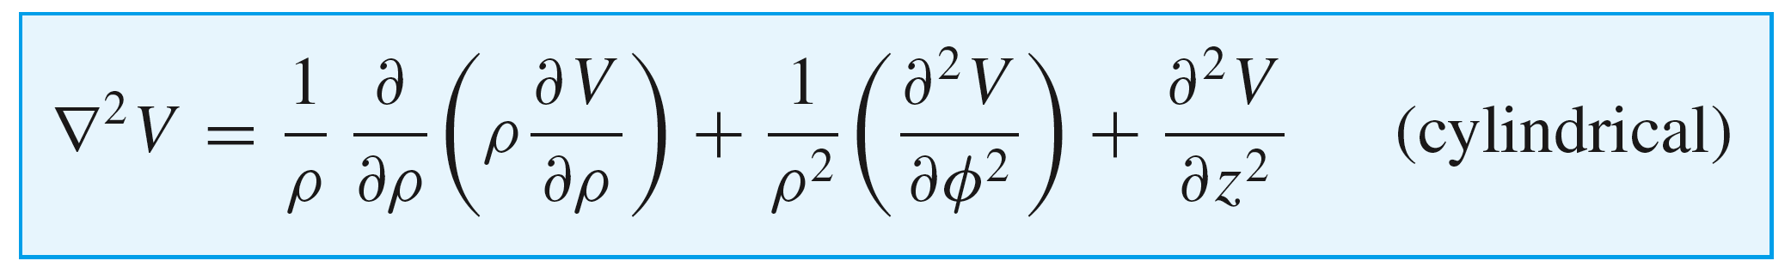
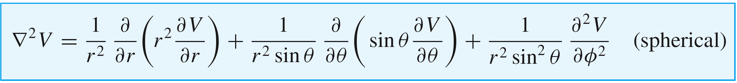
10: Capacitance
The Laplacian Operator in the Three Coordinate Systems
(Laplace’s equation)
34

Slide 12
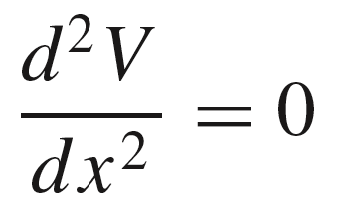
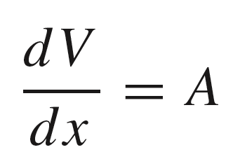
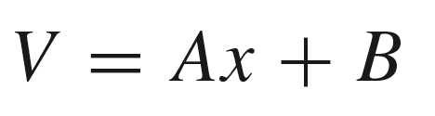
10: Capacitance
Example: Parallel Plate Capacitor
In this case, the plate separation, d, is assumed
much less than the smallest plate dimension.
Therefore V can be assumed to vary only with x.
x
V = V₀
d
Laplace’s equation reduces to:
0
V = 0
Integrating once, obtain:
Boundary conditions:
1. V = 0 at x = 0
2. V = V₀ at x = d
Integrate a second time to get:
where A and B are integration constants that are to be evaluated subject to the boundary conditions.
35

Slide 13
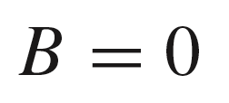
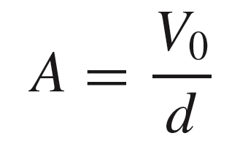
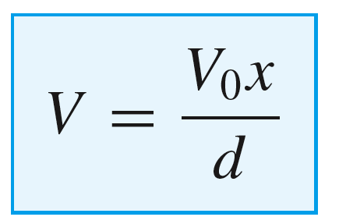
10: Capacitance
Finding Interior Potential Field
We now have:
x
Apply boundary condition 1:
V = V₀
d
0 = A(0) + B
Equipotential
Surfaces
Apply boundary condition 2:
0
V = 0
V₀ = Ad
Boundary conditions:
1. V = 0 at x = 0
Finally:
2. V = V₀ at x = d
This function is pictured by the
equipotential surfaces shown in
the capacitor, in which there is a
constant voltage difference
between adjacent surfaces
36

Slide 14
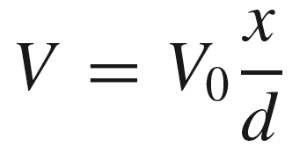
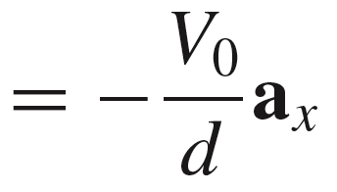
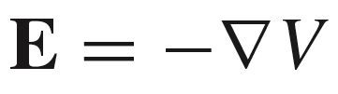
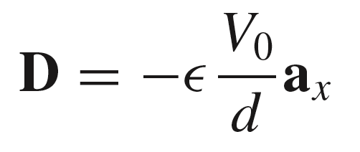

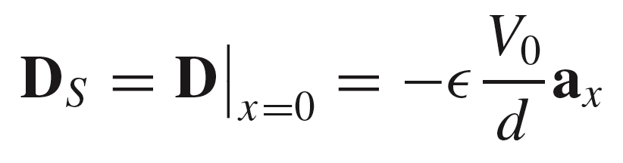
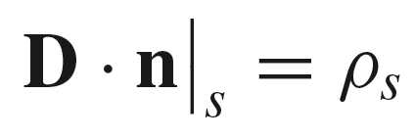
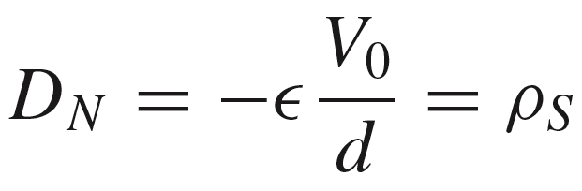
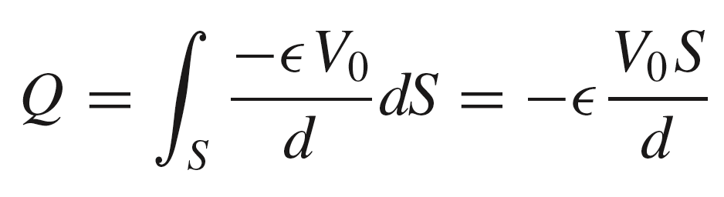
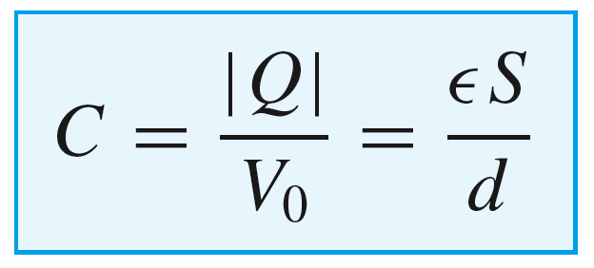
10: Capacitance
Finding the Electric Field, Charge, and Capacitance
Start with:
Surface Area = S
x
Then:
V = V₀
d
+
+
+
+
+
+
+
+
+
+
+
+
+
+
n
E
Equipotential
Surfaces
From which:
-
-
-
-
-
-
-
-
-
-
-
-
-
-
0
V = 0
At the lower plate surface (x = 0):
and
n = a_{x}
Then use:
to find
The charge on the lower plate is now:
and the
capacitance is
37

Slide 15
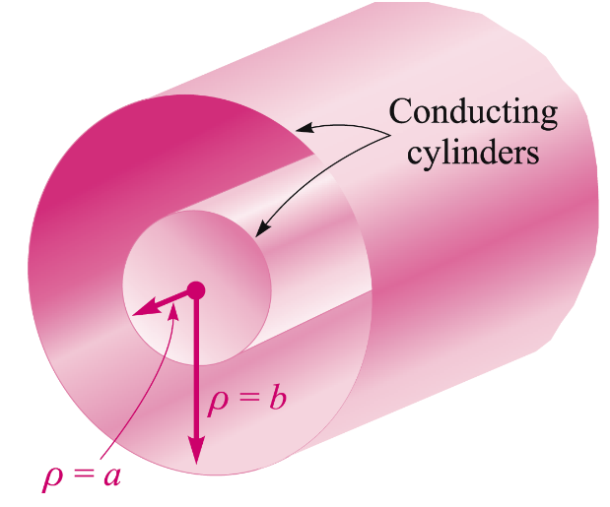
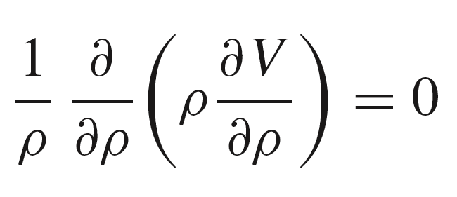
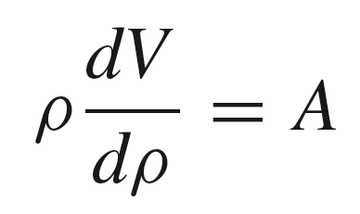
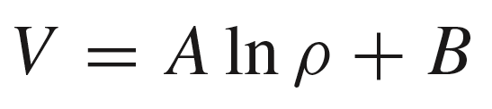
10: Capacitance
Another Example: Coaxial Transmission Line
As V is assumed to vary with radius only, Laplace’s equation becomes:
(not valid at ρ = 0)
V₀
V = 0
Our goal is to evaluate the potential function in the region (a < ρ < b)
E
L
Integrate once:
Boundary conditions:
V = 0 at ρ = b
V = V₀ at ρ = a
.. and a second time:
38

Slide 16


10: Capacitance
Another Example: Coaxial Transmission Line
Now have:
Apply boundary condition 1:
V₀
V = 0
E
L
Apply boundary condition 2:
Boundary conditions:
V = 0 at ρ = b
V = V₀ at ρ = a
Putting it all together:
39

Slide 17





10: Capacitance
Another Example: Coaxial Transmission Line
We have found the potential
field between conductors:
Then:
V₀
V = 0
E
The charge density on the inner conductor is:
L
The total charge on the inner conductor is:
…and the capacitance is finally:
40

Slide 18








10: Capacitance
Another Example: Angled Plate Geometry
Cylindrical coordinates are used, with the assumption that
potential varies only with φ.
Laplace’s equation becomes:
Integrate once:
x
…and integrate again:
Boundary Conditions:
V = 0 at φ = 0
V =V₀ at φ = α
First boundary condition:
Second boundary condition:
Finally:
Then:
41

Slide 19
10: Capacitance
Another Example: Concentric Sphere Geometry
V = 0
E
a
V₀
(Laplace’s equation)
b
Boundary Conditions:
V = 0 at r = b
V = V₀ at r = a
42

Slide 20







10: Capacitance
Another Example: Concentric Sphere Geometry
V is assumed to vary only with radius. Laplace’s equation the becomes:
or:
V = 0
E
a
V₀
b
Integrate once:
..and again:
Boundary Conditions:
V = 0 at r = b
V = V₀ at r = a
Boundary condition 1:
Boundary condition 2:
Finally:
42

Slide 21




10: Capacitance
Another Example: Concentric Sphere Geometry
We now have:
(a < r < b)
V = 0
Electric field between conductors:
E
V₀
a
b
Charge density on inner conductor:
Total charge on inner conductor:
Capacitance:
43

Slide 22



HW-6
44

Slide 23


HW-6
45

